Slide 1
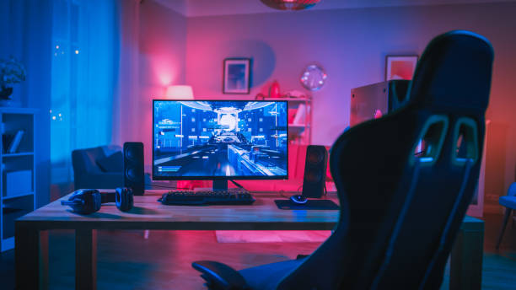
MY PROJECT:
Is a web site of buy and sale compteur in Tunisie like MEGA PC
The Most important thing in my web is to make easy to buy a pc Game

Slide 2
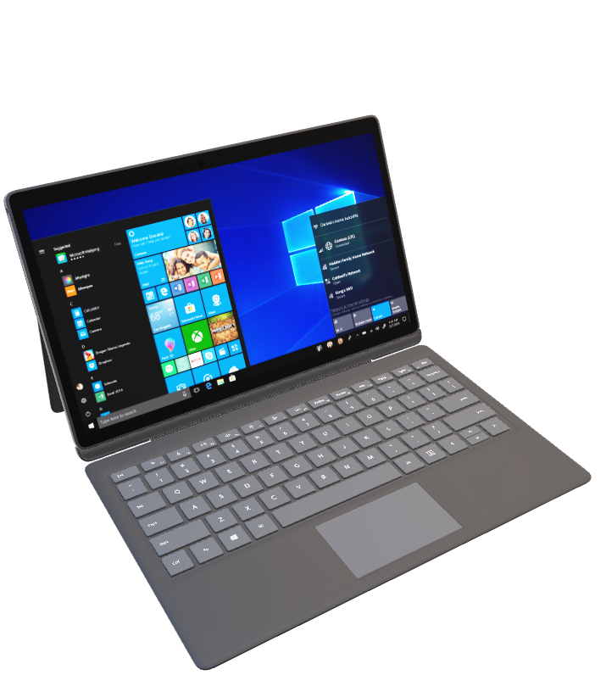
the features that i want to integrate into my project:
To have a Platform of commination with other web site who sell pc in all the world
Make easy to sell pc
Sell to other country

Slide 3


Slideshow here
accueil
home
All pages will be show here
Buy here
Sell here
The Platform
About us

